Slide 1
CONTROL UNIT DESIGN

Slide 2
Introduction
To execute instructions, the processor must have some means of generating the control signals needed in the proper sequence.
A wide variety of techniques have been used for control unit implementation. Most of these fall into one of two categories:
Types:
There are two methods to implement the control unit:
Hardwired: The control signals are generated as an output of a set of basic logic gates, the input of which derives from the binary bits in the Instruction Register.
Microprogrammed: The control signals are generated by a microprogram that is stored in Control Read Only Memory.

Slide 3
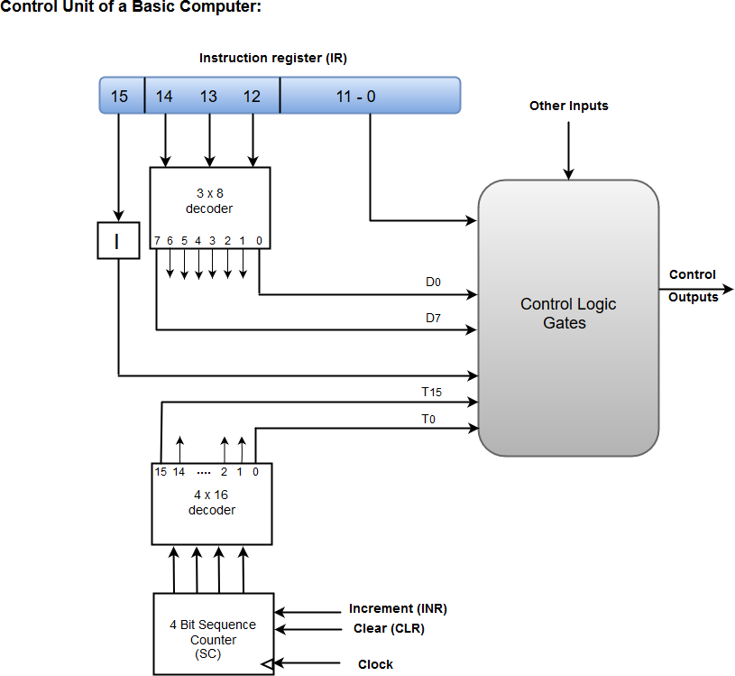
HARDWIRED CONTROL UNIT
The hardwired control unit generates the control signals to execute the instructions in a proper sequence and at the correct time. The hardwired control unit is created with the hardware; it is a circuitry approach. It is designed for the RISC style instruction set.

Slide 4
A Hard-wired Control consists of two decoders, a sequence counter, and a number of logic gates.
An instruction fetched from the memory unit is placed in the instruction register (IR).
The component of an instruction register includes; I bit, the operation code, and bits 0 through 11.
The operation code in bits 12 through 14 are coded with a 3 x 8 decoder.
The outputs of the decoder are designated by the symbols D0 through D7.
The operation code at bit 15 is transferred to a flip-flop designated by the symbol I.
The operation codes from Bits 0 through 11 are applied to the control logic gates.
The Sequence counter (SC) can count in binary from 0 through 15.
Hardwired Control Unit block diagram
The decoder/encoder is a combinational circuit that generates a set of required control signals.
A control step counter is used to keep track of the control steps. Each count of this counter corresponds to one control step.
The required control signals are determined by the following information:
Contents of the control step counter
Contents of IR register
Contents of the condition code flags
External input signals, like MFC and interrupt request

Slide 5
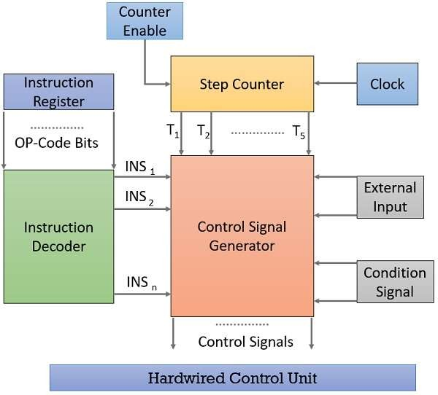
Hardwired Control Unit

Slide 6
Hardwired Control Unit
Advantages of Hardwired Control Unit:
Fast because control signals are generated by combinational circuits.
The delay in generation of control signals depends upon the number of gates.
Disadvantages of Hardwired Control Unit:
More the control signals required by CPU, more complex will be the design of control unit.
No Flexibility. Modification in control signal is very difficult i.e. it requires rearranging of wires in the hardware circuit.
Difficult to add new feature in existing design of control unit.

Slide 7
Hardwired Control Unit Design Methods
State-table Method
Delay-element Method
Uses clocked delay element (D-Flip Flop)
Sequence-counter Method
Uses counter for timing purposes
PLA Method
Uses programmable logic array

Slide 8
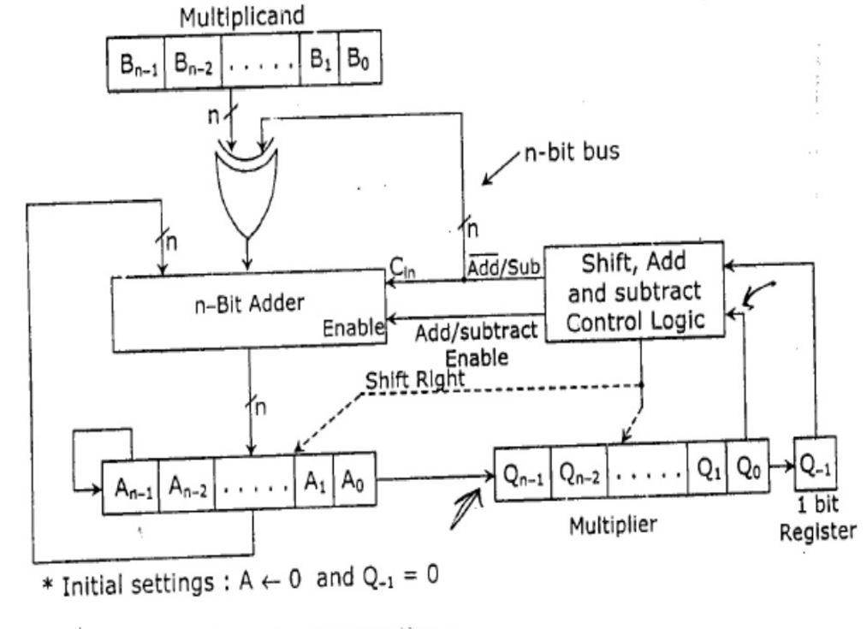
Hardwired Control Unit Design Methods (cont.)
Let us consider 2’s complement multiplier control circuit for illustration.

Slide 9
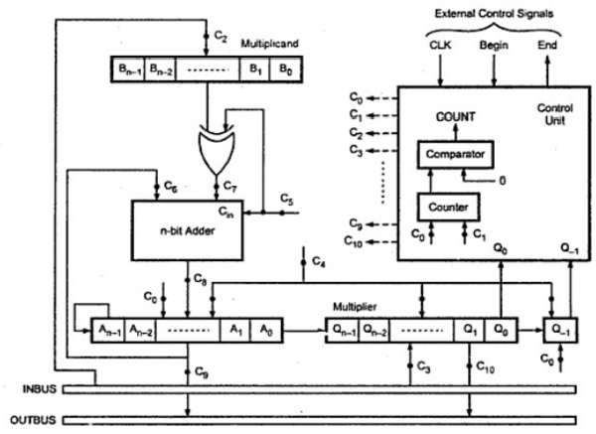
Hardwired Control Unit Design Methods (cont.)
Multiplier control circuit with control signals

Slide 10
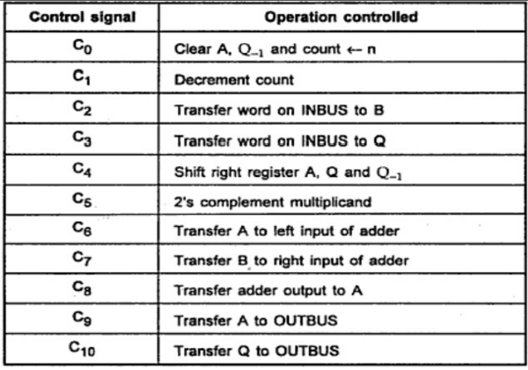
Hardwired Control Unit Design Methods (cont.)
Control signals for 2’s complement multiplier

Slide 11
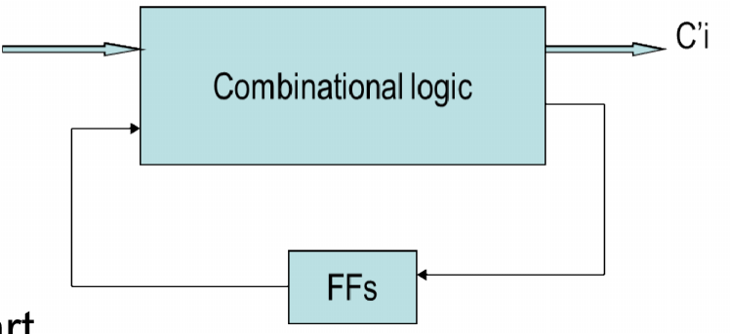
State-table Method
Classical method of sequential circuit design.
Attempts to minimize the amount of hardware.
It starts with the construction of state transition table. In every state the control unit generates a set of control signals.
Control unit transmits from one state to another state depending on its:
Current state
Input to the controller
Ij
The state Si (i=1,2…) has been marked above
each block of the flowchart.

Slide 12
State-table Method (cont.)
State Assignment: States are assigned as S1,S2,S3…;each such assignment specifies a particular state of the controller at the specific time step. State table derived from state assignment
State Minimization: A set of states {Sa,Sb,…Sc} can be merged to a single state S’ if Si & Sj is pair wise compatible
State Encoding: State variables are defined and states are encoded in terms of state variables

Slide 13
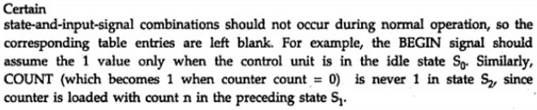
State-table Method (cont.)
2’s complement multiplier
State table construction is necessary.
Associate a state with every micro-operation block giving nine states from S₀ through S_{8.}
There are four primary input signals BEGIN, COUNT, Q₀ and Q₋₁, so sixteen possible input combinations.
Each entry in the table indicates next state followed by list of control signals that are activated.
Note:

Slide 14
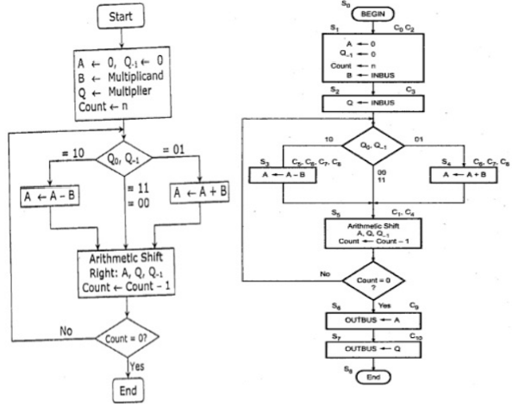
State-table Method (cont.)
Flowchart for 2’s complement multiplication

Slide 15
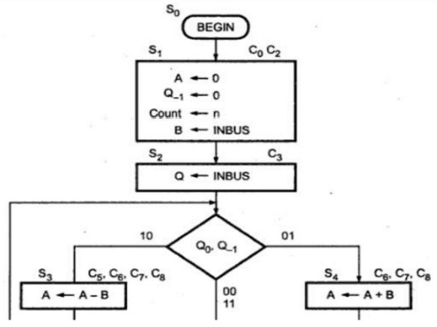
State-table Method (cont.)

Slide 16
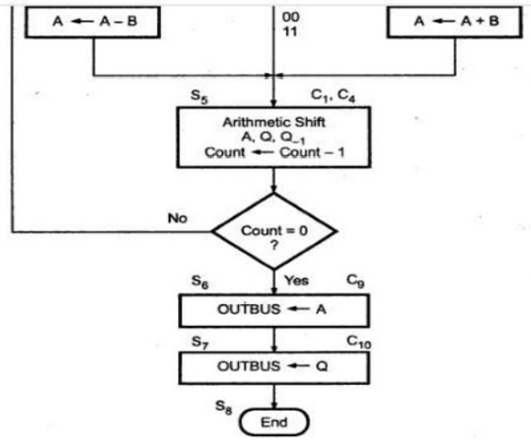
State-table Method (cont.)

Slide 17
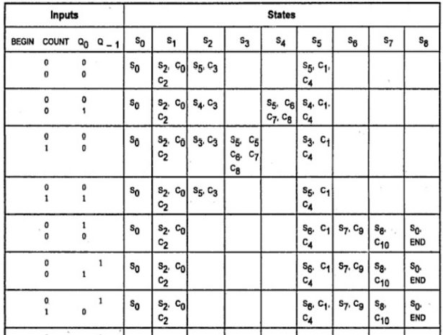
State-table Method (cont.)
State table for multiplier control unit

Slide 18
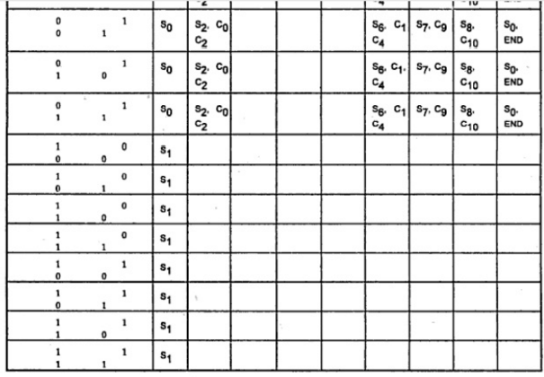
State-table Method (cont.)
State table for multiplier control unit (cont.)

Slide 19
Delay-element Method
Control signals or groups of control signals are activated in proper sequence.
There is a specific time delay between activation of two consecutive control signals or groups of control signal.
For synchronous operation, delay implemented using D flip-flops and common clock signal.
elements are controlled by

Slide 20
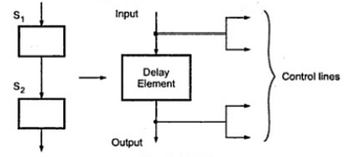
Rules for Delay-element Method
1. Each sequence of two successive micro-operations requires a delay element.

Slide 21
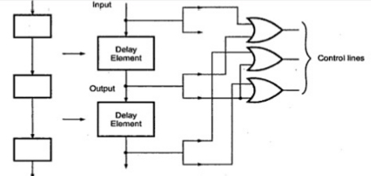
Rules for Delay-element Method (cont.)
2. The signals that are intended to activate same control lines are logically ORed to get one common output signals.

Slide 22
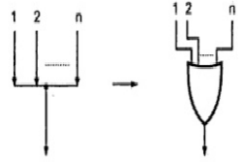
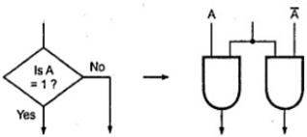
Rules for Delay-element Method (cont.)
3. n lines in the flowchart merge to a common line are transformed into n input OR gate.
Figure a
4. A decision box can be implemented by two AND gates as shown in figure b
Figure b

Slide 23
Controller specification for the Fetch Sequence
Address of next instruction is in PC (S01)
Content of PC loaded into MAR (C01), S02
Address (MAR) is placed on address bus
Control unit issues READ command
Result (data from memory) appears on data bus
Data from data bus copied into MDR (C02), S03
PC incremented by 1 (in parallel with data fetch from memory) (C03), S03
Data (instruction) moved from MDR to IR (C04), S04
MDR is now free for further data fetches (F 0 ; E 1) (C05), S05

Slide 24
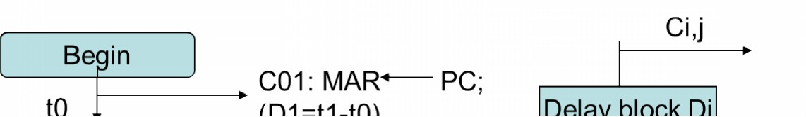
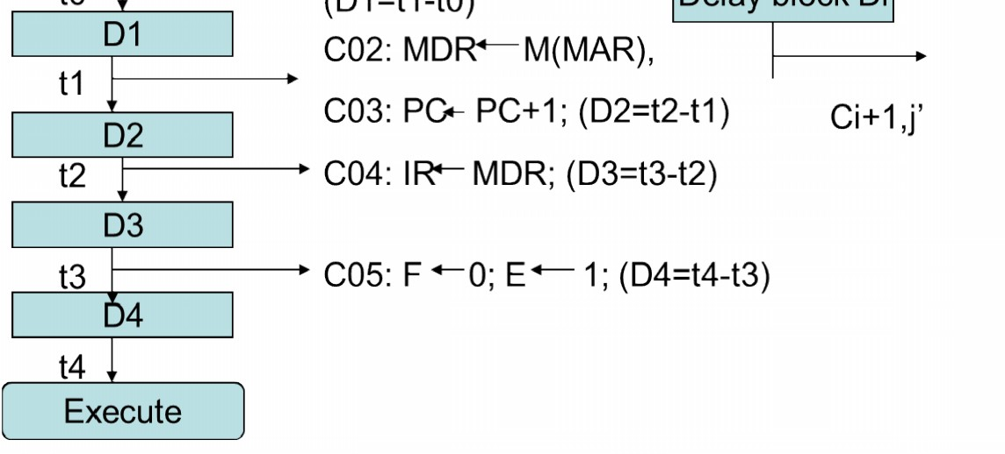
Delay-element Method (cont.)
Control unit based on delay element method fetch cycle
for the

Slide 25
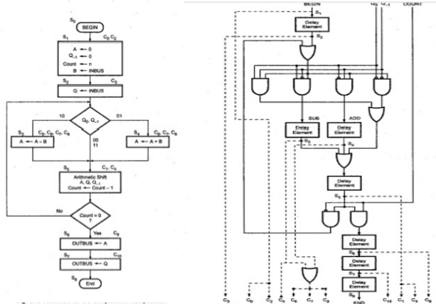
Delay-element Method (cont.)
Implementation of multiplier control unit from flowchart by using transformation rules

Slide 26
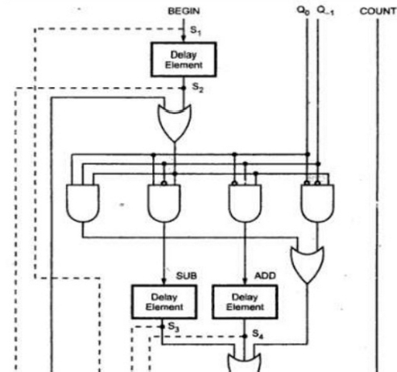
Delay-element Method (cont.)
Multiplier control unit using delay elements

Slide 27
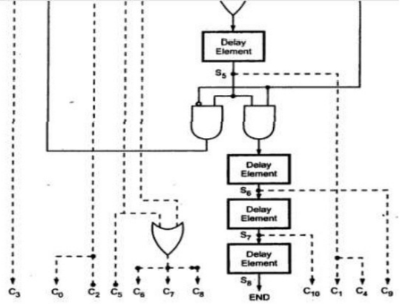
Delay-element Method (cont.)
Multiplier control unit using delay elements (cont.)

Slide 28
Sequence-counter Method
Step 1: Identify the distinct phases in the flowchart. Employ log p number of flip flops to handle p number distinct phases
Begin
R
1
Count enable
Modulo–k counter
End
S
0
Reset
Reset
Clock
Reset
Step 2: Identify the maximum number of distinct steps, k, in each of the phases. Employ a mod k counter to generate control signals for each of the k steps
…..
Enable
I/k Decoder
……
Step 3 : design a combinational logic circuit to generate the sequence of control signals to control the micro operations of each phase
c1c2
ck

Slide 29
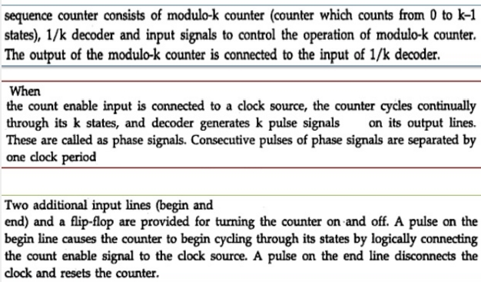
Sequence-counter Method

Slide 30
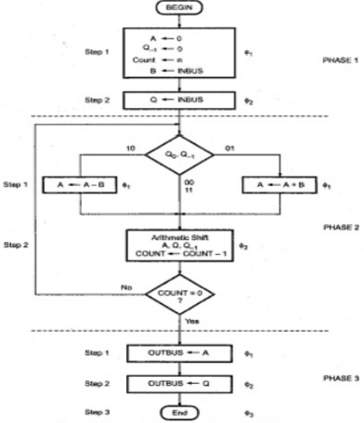
Sequence-counter Method
Flowchart for 2’s complement multiplication

Slide 31
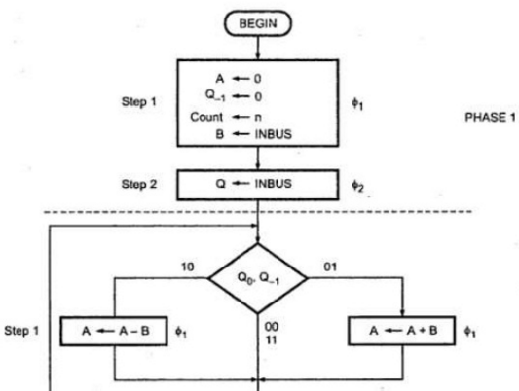
Sequence-counter Method
Flowchart for 2’s complement multiplication (cont.)

Slide 32
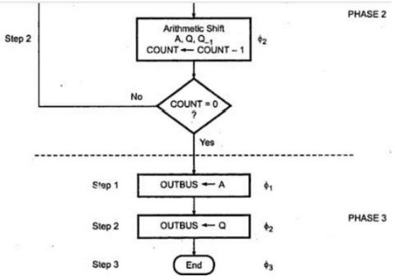
Sequence-counter Method
Flowchart for 2’s complement multiplication (cont.)

Slide 33
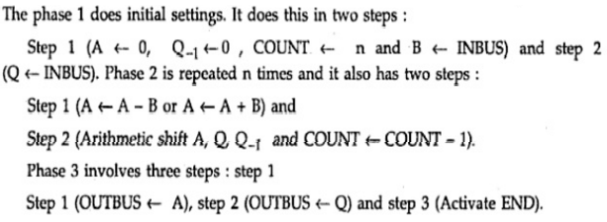
Sequence-counter Method

Slide 34
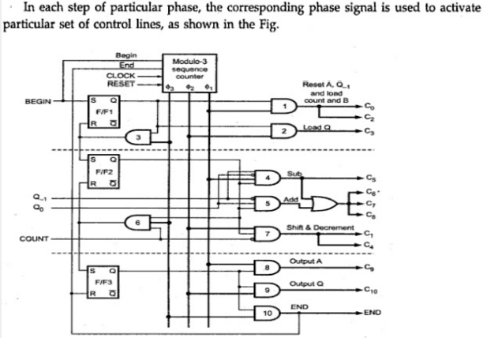
Sequence-counter Method
Multiplier control unit using Sequence counter method

Slide 35
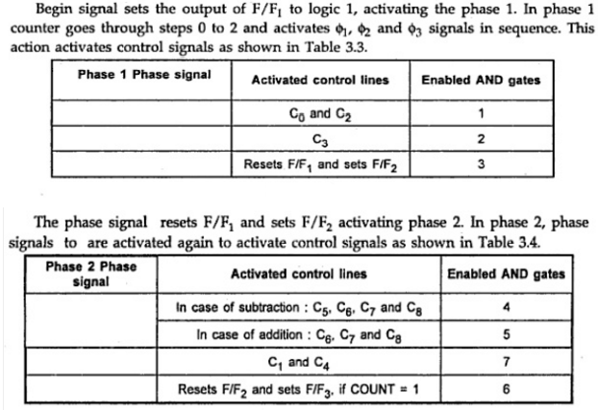
Sequence-counter Method

Slide 36
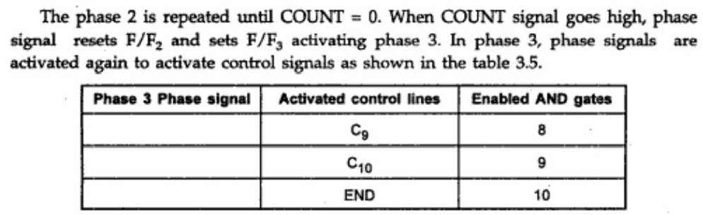
Sequence-counter Method

Slide 37
Micro-Programmed Control Unit
A micro-programmed control unit is implemented using programming approach. A sequence of microoperations are carried out by executing a program consisting of micro-instructions.
Micro-program, consisting of micro-instructions is stored in the control memory of the control unit.
Execution of a micro-instruction is responsible for generation of a set of control signals.
Important Terms
Control Word: - The control variables at any time are represented by 1’s and 0’s, known as Control Word. Control words can be programmed to perform various operations.
Micro-Operations: The operations performed on the data stored inside the
registers are called micro-operations.
Micro-Programs: Microprogramming is the concept for generating control signals using programs. These programs are called micro-programs.
Micro-Instructions: The instructions that make micro-program are called
micro-instructions.
Micro-Code: Micro-program is a group of microinstructions. The micro-
program can also be termed as micro-code.
Control Memory: Micro-programs are stored in the read only memory (ROM). That memory is called control memory.

Slide 38
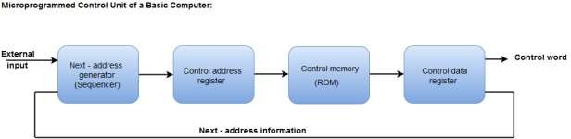
Micro-Programmed control Organization
Control Memory
Control Address Register
Sequencer (Next Address Generator)
Control Data Register (Pipeline Register)

Slide 39
Types of memory in MPC
Main Memory
The main memory is used for storing programs. The content of the main memory can be altered when data is manipulated and each time the program is changed. Program in main memory contains machine instructions and data.
Control Memory
Memory that is a part of the control unit is called Control memory. Control memory holds microprograms that cannot be altered by the user. The microprogram consists of microinstructions to execute register microoperations.
Machine instruction initiates a series of microinstructions in the control memory. The microinstruction generates microoperations to fetch instructions from main memory, to evaluate effective address, to execute the operations specified by instructions or to repeat the cycle for the next instruction.
Sequencer and Pipeline Register
Sequencer: The next address generator is called a sequencer, as it determines the address sequence that is read from the control memory.

Slide 40
Functions:
Incrementing the control register
Loading an address from control memory to CAR.
Loading an initial address
Pipeline Register: The control data register holds the present microinstruction while the next address is computed and read from the memory. This data register is called pipeline register.
Selection of address for Control Memory
Address Sequencing
Address Sequencing = Sequencer: Next Address Generator. Selection of address for control memory
Routine: Microinstruction are stored in control memory in groups
Mapping
Instruction Code Address in control memory (where routine is located) Address Sequencing Capabilities: control memory address
Incrementing of the control address register
Unconditional branch or conditional branch, depending on status bit conditions
Mapping process (bits of the instruction address for control memory )
A facility for subroutine return

Slide 41
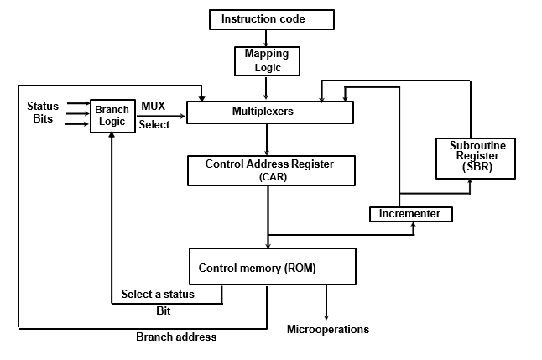

Slide 42
Multiplexer
CAR Increment
JMP/CALL
Mapping
Subroutine Return
Control Address Register CAR: CAR receive the address from 4 different paths:
Incrementer
Branch address from control memory
Mapping Logic
SBR Subroutine Register
SBR Subroutine Register: Return Address cannot be stored in ROM. Return Address for a subroutine is stored in SBR
Conditional Branching
Status Bits: Control the conditional branch decisions generated in the Branch Logic
Branch Logic: Test the specified condition and Branch to the indicated address if the condition is met; otherwise, the control address register is just incremented.
Mapping of Instruction
Mapping: transformation from instruction code bits to microinstruction address in control memory where routine is located.
Each computer instruction has its own microprogram Routine stored in a given location of the control memory

Slide 43
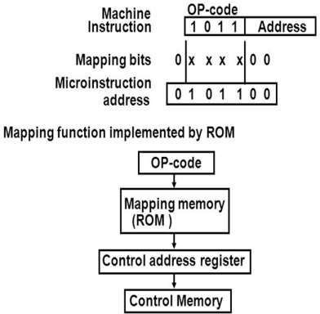

Slide 44
4 bit Opcode = specify up to 16 distinct instruction
Mapping Process: Converts the 4-bit Opcode to a 7-bit control memory address
Place a “0” in the most significant bit of the address
Transfer 4-bit Operation code bits
Clear the two least significant bits of the CAR
Subroutine
Subroutines are programs that are used by other routines. Subroutine can be called from any point within the main body of the microprogram
Subroutine must have a provision for:
Storing the return address during a subroutine call
Restoring the address during a subroutine return (Last-In First Out(LIFO) Register Stack)
Micro-instruction Types
Vertical Micro-Programming : Each micro-instruction specifies single (or few) micro-operations to be performed
Horizontal Micro-Programming : Each micro-instruction specifies many different micro-operations to be performed in parallel
Vertical Micro-programming
Width is narrow
n control signals encoded into log2 n bits
Limited ability to express parallelism
Considerable encoding of control information requires external memory word decoder to identify the exact control line being manipulated

Slide 45
Microprogram Example
MUX
Computer
Configuration
10
0
AR
Address
Memory
10
0
2048 x 16
PC
MUX
6
0
6
0
15
0
DR
SBR
CAR
Control memory
Arithmetic
logic and
shift unit
128 x 20
Control unit
15
0
AC

Slide 46
Microprogram Example
Computer instruction format
15
14
11
10
0
I
Opcode
Address
Four computer instructions
Symbol OP-code Description
EA is the effective address
ADD 0000 AC ← AC + M[EA]
BRANCH 0001 if (AC < 0) then (PC ← EA)
STORE 0010 M[EA] ← AC
EXCHANGE 0011 AC ← M[EA], M[EA] ← AC
Microinstruction Format
3
3
3
2
2
7
F1
F2
F3
CD
BR
AD
F1, F2, F3: Microoperation fields
CD: Condition for branching
BR: Branch field
AD: Address field

Slide 47
Microinstruction Fields
F1 Microoperation Symbol
000 None NOP
001 AC ← AC + DR ADD
010 AC ← 0 CLRAC
011 AC ← AC + 1 INCAC
100 AC ← DR DRTAC
101 AR ← DR(0-10) DRTAR
110 AR ← PC PCTAR
111 M[AR] ← DR WRITE
F2 Microoperation Symbol
000 None NOP
001 AC ← AC - DR SUB
010 AC ← AC ∨ DR OR
011 AC ← AC ∧ DR AND
100 DR ← M[AR] READ
101 DR ← AC ACTDR
110 DR ← DR + 1 INCDR
111 DR(0-10) ← PC PCTDR
F3 Microoperation Symbol
000 None NOP
001 AC ← AC ⊕ DR XOR
010 AC ← AC’ COM
011 AC ← shl AC SHL
100 AC ← shr AC SHR
101 PC ← PC + 1 INCPC
110 PC ← AR ARTPC
111 Reserved

Slide 48
Microinstruction Fields
CD Condition Symbol Comments
00 Always = 1 U Unconditional branch
01 DR(15) I Indirect address bit
10 AC(15) S Sign bit of AC
11 AC = 0 Z Zero value in AC
BR Symbol Function
00 JMP CAR ← AD if condition = 1
CAR ← CAR + 1 if condition = 0
01 CALL CAR ← AD, SBR ← CAR + 1 if condition = 1
CAR ← CAR + 1 if condition = 0
10 RET CAR ← SBR (Return from subroutine)
11 MAP CAR(2-5) ← DR(11-14), CAR(0,1,6) ← 0

Slide 49
Symbolic Microinstruction
Sample Format Label: Micro-ops CD BR AD
Label may be empty or may specify symbolic address
terminated with colon
Micro-ops consists of 1, 2, or 3 symbols separated by commas
CD one of {U, I, S, Z}
U: Unconditional Branch
I: Indirect address bit
S: Sign of AC
Z: Zero value in AC
BR one of {JMP, CALL, RET, MAP}
AD one of {Symbolic address, NEXT, empty}

Slide 50
Fetch Routine
Fetch routine
- Read instruction from memory
- Decode instruction and update PC
Microinstructions for fetch routine:
AR ← PC
DR ← M[AR], PC ← PC + 1
AR ← DR(0-10), CAR(2-5) ← DR(11-14), CAR(0,1,6) ← 0
Symbolic microprogram for fetch routine:
FETCH:
ORG 64
PCTAR U JMP NEXT
READ, INCPC U JMP NEXT
DRTAR U MAP
Binary microporgram for fetch routine:
Binary
address F1 F2 F3 CD BR AD
1000000 110 000 000 00 00 1000001
1000001 000 100 101 00 00 1000010
1000010 101 000 000 00 11 0000000

Slide 51
Symbolic Microprogram
Control memory: 128 20-bit words
First 64 words: Routines for 16 machine instructions
Last 64 words: Used for other purpose (e.g., fetch routine and other subroutines)
Mapping: OP-code XXXX into 0XXXX00, first address for 16 routines are
0(0 0000 00), 4(0 0001 00), 8, 12, 16, 20, ..., 60
Partial Symbolic Microprogram
Label Microops CD BR AD
ADD:
BRANCH:
OVER:
STORE:
EXCHANGE:
FETCH:
INDRCT:
ORG 0
NOP
READ
ADD
ORG 4
NOP
NOP
NOP
ARTPC
ORG 8
NOP
ACTDR
WRITE
ORG 12
NOP
READ
ACTDR, DRTAC
WRITE
ORG 64
PCTAR
READ, INCPC
DRTAR
READ
DRTAR
I
U
U
S
U
I
U
I
U
U
I
U
U
U
U
U
U
U
U
CALL
JMP
JMP
JMP
JMP
CALL
JMP
CALL
JMP
JMP
CALL
JMP
JMP
JMP
JMP
JMP
MAP
JMP
RET
INDRCT
NEXT
FETCH
OVER
FETCH
INDRCT
FETCH
INDRCT
NEXT
FETCH
INDRCT
NEXT
NEXT
FETCH
NEXT
NEXT
NEXT

Slide 52
Binary Microprogram
Address Binary Microinstruction
Micro Routine Decimal Binary F1 F2 F3 CD BR AD
ADD 0 0000000 000 000 000 01 01 1000011
1 0000001 000 100 000 00 00 0000010
2 0000010 001 000 000 00 00 1000000
3 0000011 000 000 000 00 00 1000000
BRANCH 4 0000100 000 000 000 10 00 0000110
5 0000101 000 000 000 00 00 1000000
6 0000110 000 000 000 01 01 1000011
7 0000111 000 000 110 00 00 1000000
STORE 8 0001000 000 000 000 01 01 1000011
9 0001001 000 101 000 00 00 0001010
10 0001010 111 000 000 00 00 1000000
11 0001011 000 000 000 00 00 1000000
EXCHANGE 12 0001100 000 000 000 01 01 1000011
13 0001101 001 000 000 00 00 0001110
14 0001110 100 101 000 00 00 0001111
15 0001111 111 000 000 00 00 1000000
FETCH 64 1000000 110 000 000 00 00 1000001
65 1000001 000 100 101 00 00 1000010
66 1000010 101 000 000 00 11 0000000
INDRCT 67 1000011 000 100 000 00 00 1000100
68 1000100 101 000 000 00 10 0000000

Slide 53
Design of Control Unit
microoperation fields
F1
F2
F3
3 x 8 decoder
3 x 8 decoder
3 x 8 decoder
7
6
5
4
3
2
1
0
7
6
5
4
3
2
1
0
7
6
5
4
3
2
1
0
AND
AC
DR
ADD
Arithmetic
DRTAC
logic and
shift unit
From
From
PCTAR
DRTAR
PC
DR(0-10)
Load
AC
Select
0
1
Multiplexers
Load
AR
Clock

Slide 54
Microprogram Sequencer
External
(MAP)
I₀
L
3
2
1
0
I₁
Input
S₁
SBR
Load
logic
S₀
MUX1
T
1
Incrementer
I
MUX2
Test
S
Z
Select
Clock
CAR
Control memory
Microops
CD
BR
AD
. . .
. . .

Slide 55
Input Logic for Microprogram Sequencer
From
CPU
1
Test
L
L(load SBR with PC) for subroutine Call
I
MUX2
T
S
BR field
of CS
Input
Z
Select
I₀
logic
S₀
S₁
for next address
selection
I₁
CD Field of CS
Input Logic
I1I0T Meaning Source of Address S₁S₀ L
000 In-Line CAR+1 00 0
001 JMP CS(AD) 01 0
010 In-Line CAR+1 00 0
011 CALL CS(AD) and SBR <- CAR+1 01 1
10x RET SBR 10 0
11x MAP DR(11-14) 11 0
S1 = I1
S₀ = I₀I₁ + I1’T
L = I₁’I0T

Slide 56
Microprogrammed Control Unit
Control Word(CW):
A word where individual bits represents the various control signals.
Microroutine:
A sequence of CWs corresponding to the control sequence of a machine instruction.
Microinstruction:
The individual control word in microroutine.
Control Store:
The microroutine for all instructions in instruction set of a computer are stored in a special memory called control store.

Slide 57
Microinstructions
Each line in microroutine/microprogram describes a set of micro-operations occurring at one time and is known as a microinstruction.
Different formats of microinstruction depending on the encoding of control signals.
Horizontal microinstructions
Vertical microinstructions

Slide 58
Horizontal Microinstructions
Each bit directly controls each micro-operation or each control signal.
A Horizontal microinstruction has the following general attributes:
long microinstruction word
high degree of parallelism
little encoding of control information

Slide 59
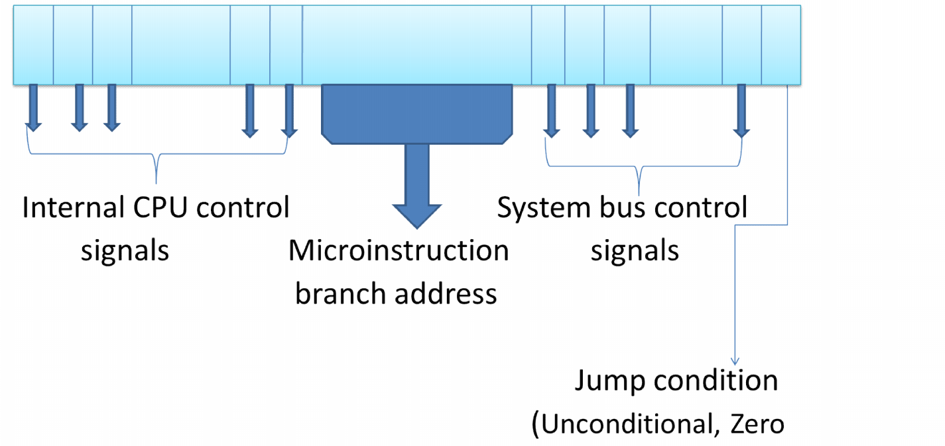
Horizontal Microinstructions

Slide 60

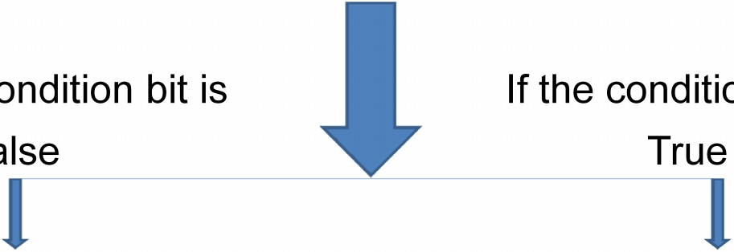
Horizontal Microinstructions
Execution of horizontal microinstruction
Turn on all control lines with bit value equal to 1
If the condition bit is False
If the condition bit is True
Execute the next microinstruction in the sequence.
Next microinstruction to be executed is indicated in the address field.

Slide 61
Vertical Microinstructions
A Vertical microinstruction has general attributes:
short microinstruction word
the following
limited ability operations
considerable information
to express parallel
encoding of the
micro-
control

Slide 62
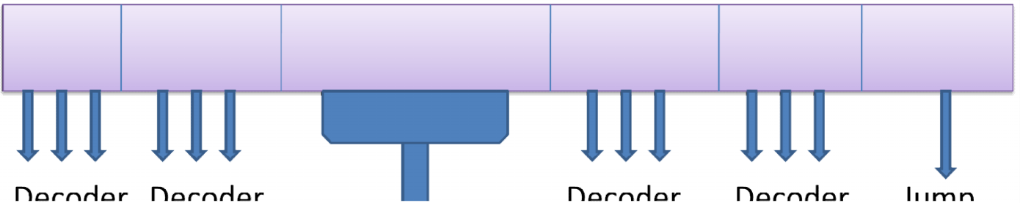
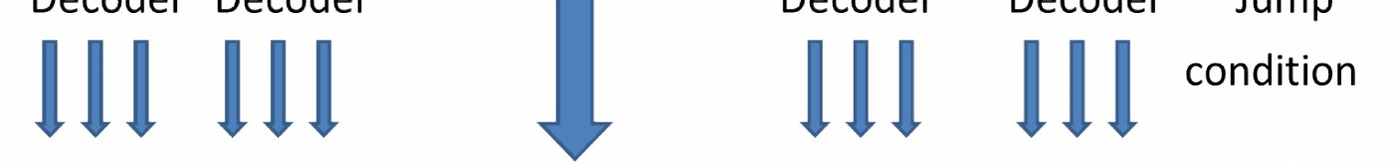
Vertical Microinstructions

Slide 63
Vertical Microinstructions
Many similar control signals can be encoded into few microinstruction bits.
For example, for 32 ALU operations, only 5 encoded bits will be required in vertical microinstruction.
However, these encoded bits need to be passed from respective decoders to get the individual control signals.

Slide 64
Microprogrammed control unit
Advantages:
It simplifies the design of control unit. Thus it is both, cheaper and less error prone to implement.
Control functions are implemented in software rather than hardware.
More flexible, can be changed to accommodate new system specification or to correct design error.
Debugging and maintenance of a microprogrammed CPU is easy.
Disadvantages:
Slower than the hardwired control unit, because time is required to access the microinstruction from control store.
The flexibility is achieved at some extra hardware cost due to the control memory and its access circuitry.
The design duration of microprogrammed control unit is more than hardwired control unit for smaller CPU.

Slide 65
Comparison between Hardwired and Microprogrammed Control Unit
Sr. No | Attribute | Hardwired | Microprogrammed
1 | Speed | Fast | Slow
2 | Cost of implementation | More | Cheaper
3 | Implementation approach | Sequential circuit | Programming
4 | Flexibility | Not flexible | Flexible
5 | Ability to handle complex instruction | Difficult | Easier
6 | Design process | Complicated | Systematic
7 | Decoding and sequencing logic | Complex | Easy
8 | Application | RISC µp | CISC µp
9 | Control memory | Absent | Present
10 | Chip area | Less | more

Slide 66
Thank you

